Slide 2
Sodium Glucose Cotransporter 2 Inhibitors and Their Influence on the Renin-Angiotensin System
DR.M.Amerian

Slide 3
The role of SGLTs in the kidney Sodium-glucose transporters:
(SGLTs) are cell-membrane symporters that transfer sodium, together with glucose, into the cell down and against the concentration gradient
SGLT2 is a high-capacity low-affinity transporter located in the first segment of the proximal tubule and is responsible for the reabsorption of about 90% of filtered glucose.
Residual glucose is reabsorbed by the high-affinity low-capacity transporter SGLT1 in the distal segment of the proximal tubule .

Slide 4
In an individual with preserved glomerular filtration rate (GFR) and normoglycemia, all the glucose filtered in the proximal tubules is reabsorbed; an increase in the concentration of plasma glucose leads to a constant increase in filtered glucose, until the threshold of reabsorption is reached (normally for values of glycemia around 180–215 mg/dl) and glycosuria begins.
renal glucose reabsorption probably through an increased activity of SGLT2 in the proximal tubules, sustaining hyperglycemia in a sort of vicious cycle .

Slide 5
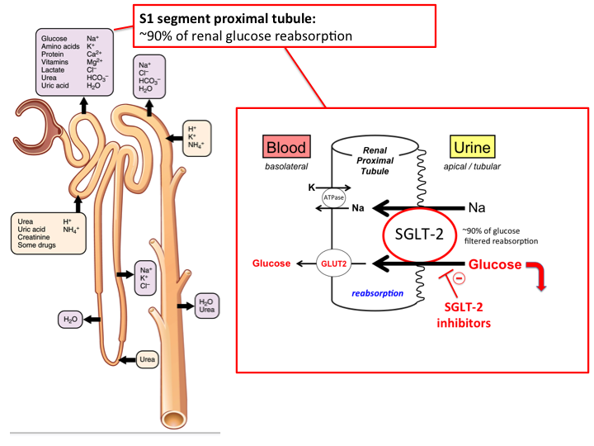

Slide 6
Sodium glucose cotransporter 2 (SGLT2) inhibitors:
Sodium glucose cotransporter 2 (SGLT2) inhibitors are a relatively new class of antidiabetic drugs via an insulin-independent mechanism, through their glycosuric effect.
Four SGLT2 inhibitors—canagliflozin, dapagliflozin, empagliflozin, and ertugliflozin—are currently approved by the US Food and Drug Administration (FDA) as glucose-lowering drugs.
Two more SGLT2 inhibitors, sotagliflozin and bexagliflozin, are currently in phase III clinical trials for type 2 diabetes.

Slide 7
A few different properties among the SGLT2 inhibitors have been reported.
For example, in vitro studies have shown that canagliflozin is less selective between SGLT2 and SGLT1 than other SGLT2 inhibitors .

Slide 8
1.Direct renal benefits of SGLT2i :
There are different direct effects of SGLT2i on kidney homeostasis that can explain the favorable renal outcomes. Firstly, SGLT2i, by reducing sodium reabsorption at the proximal tubules, causes an increase of sodium concentration at the macula densa, which in turn enhances sodium entrance in the cell and therefore its osmolarity .

Slide 9
The net effect is an increase in ATP’s conversion to adenosine leading to vasoconstriction of the afferent arterioles—via the tubuloglomerular feedback—and to a reduction of GFR.
This process reduces glomerular hyperfiltration, intraglomerular pressure, and consequently barotrauma and proteinuria, which are typical events of the early stage of diabetic nephropathy and HF, thus slowing the progression of nephropathy.

Slide 10
2. Diuretic Effects of SGLT2 Inhibitors:
Osmotic diuresis induced by SGLT2i is particularly relevant in the situation of interstitial volume overload working in synergy with the other diuretics, in particular loop diuretics .
SGLT2i primarily reduces interstitial volume, with a minor effect on intravascular volume, while loop diuretics mostly reduce intravascular volume.
Dapagliflozin has been shown to reduce plasma volume in a similar way to thiazide diuretics, but dapagliflozin has a more enduring diuretic effect than other diuretics .

Slide 11
The diuretic actions of SGLT2 inhibitors presumably play an important role in cardioprotection, as shown in the EMPA-REG OUTCOME study and the CANVAS program. SGLT2 inhibitors have acutely caused an increase in urinary sodium excretion in non-diabetic and in diabetic rats .
In type 2 diabetic patients, increased urinary sodium excretion has been observed during the early phase of treatment with canagliflozin and empagliflozin .
Antihypertensive effects found in the EMPA-REG OUTCOME study and the CANVAS program are probably due to natriuresis induced by the SGLT2 inhibitors

Slide 12
Over the last decade, sodium accumulation in tissues has received growing attention as a marker of volume-expanded states . Sodium concentrations in the skin and muscles are reportedly positively correlated with the risk of cardiovascular diseases and blood pressure in chronic kidney disease .
Interestingly, chronic treatment with dapagliflozin significantly reduces sodium concentrations in the skin of type 2 diabetic patients .
These data support the hypothesis that SGLT2 inhibitors decrease the sodium concentration in interstitial fluid and thus reduce the risk of cardiovascular diseases.

Slide 13
3. Effects of SGLT2 Inhibitors on RAS Activity:
Inappropriate activation of the RAS is a critical factor in the pathogenesis of cardiovascular and renal diseases associated with diabetes .
In response to stimuli such as reduced renal perfusion pressure and sodium load at the distal tubules, renin release from the juxtaglomerular cells is significantly increased .
SGLT2 inhibitors can cause natriuresis, at least in the early phase of treatment, resulting in systemic RAS activation.

Slide 14
The modulation of RAAS by SGLT2i has not been fully clarified.
It has been suggested that this class of drugs activates the non-classic pathway of RAAS by stimulating the type 2 angiotensin II receptor with vasodilatation and anti-inflammatory properties, instead of the classic propathogenetic pathway via the type 1 angiotensin II receptors

Slide 15
3.1. Systemic RAS:
In patients with essential hypertension, treatment with diuretics often elevates PRA, probably because of body fluid loss .
Similarly, SGLT2 inhibitor-induced osmotic diuresis, natriuresis, and the associated reductions in extracellular volume and blood pressure might activate the systemic RAS in diabetes .

Slide 16
In Otsuka Long-Evans Tokushima fatty (OLETF) rats, a type 2 diabetic model, PRA and serum aldosterone levels are significantly increased and remain unchanged upon chronic treatment with Dapagliflozin .
Similarly, the levels of systemic RAS components do not change significantly after 10 weeks of SGLT2 inhibitor treatment in a chronic kidney disease rat model .
In clinical studies, Dapagliflozin has increased PRA and serum aldosterone after 12 weeks of treatment in type 2 diabetic patients.

Slide 17
Conversely, PRA did not change significantly after chronic treatment of type 2 diabetic patients with SGLT2 inhibitors in another study.
available clinical data have shown that the plasma aldosterone level did not significantly change by treatment with an SGLT2 inhibitor .

Slide 18
This may be because aldosterone production is stimulated not only by Ang II, but also by other factors, such as adrenocorticotropic hormone and potassium.
Moreoverthe diuretic action of SGLT2 inhibitors is usually transient and is no longer observed a few days after treatment .

Slide 19
4. Effects of SGLT2 Inhibitors on Sympathetic nervous system:
Elevated sympathetic activity is a major risk factor for renal disease and a known feature of diabetic patients .
The cross-talk between the sympathetic nervous system and SGLT2 has been proved with compelling evidence in animal models: it has been demonstrated that chemical sympathetic denervation in neurogenic hypertensive mice resulted in reduced renal SGLT2 expression, and that Dapagliflozintreated mice showed a significant decrease in the expression of markers of sympathetic activity and a reduction in blood pressure .

Slide 20
Furthermore, SGLT2 inhibitors improve the circadian rhythm of sympathetic nerve activity while their effects on sympathetic nerve activity may also influence the activity of the systemic RAS.

Slide 21
3.2. Intrarenal RAS:
Studies have indicated that the liver is the source of AGT in both plasma and kidneys . However, it has also been shown that AGT is locally expressed in proximal tubules .
Treatment with an SGLT2 inhibitor may affect intrarenal AGT production via changes in glucose levels.

Slide 22
Administration of high glucose (15 mM) has significantly increased AGT mRNA levels in cultured human proximal tubular cells . Therefore, a reduction in blood sugar levels with SGLT2 inhibitors may decrease AGT production in the early proximal tubule.
Conversely, SGLT2 inhibition can increase glucose delivery to the distal proximal tubule, and, therefore, AGT production may be stimulated.
Different effects of SGLT2 inhibitors on AGT production between early and distal proximal tubules may explain the inconsistent data regarding the responses of intrarenal RAS to SGLT2 inhibitors.

Slide 23
In patients with type 2 diabetes, treatment with SGLT2 inhibitors also tended to decrease urinary AGT excretion, although these changes were not statistically significant .
In contrast, in patients with type 1 diabetes, treatment with empagliflozin significantly increased the urinary AGT/creatinine ratio .
Importantly, several studies have indicated a higher urinary AGT/creatinine ratio in patients with type 2 diabetes than in patients with type 1 diabetes .
Thus, the basal activity of intrarenal RAS may influence the SGLT2 inhibitor’s effect on it.

Slide 24
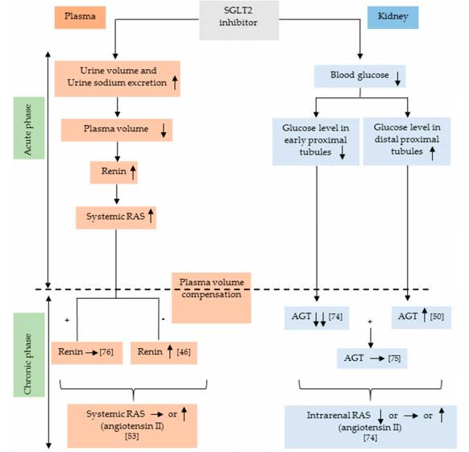

Slide 25
Conclusion:
The transient diuretic effects potentially lead to systemic RAS activation.
However, the association between SGLT2 inhibitors and systemic RAS activation is not straightforward.
Furthermore, data have indicated that chronic treatment with SGLT2 inhibitors does not activate the intrarenal RAS in type 2 diabetic patients.
Future work is thus needed to develop stable biomarkers for both the systemic and intrarenal RAS.

Slide 26
ممنون از توجه شما

