Slide 1
Non-facial Botulinum toxin Injections
Kamran Jazayeri, MD
Dermatologist
Private practice
Tehran

Slide 2
Neck rejuvenation

Slide 3
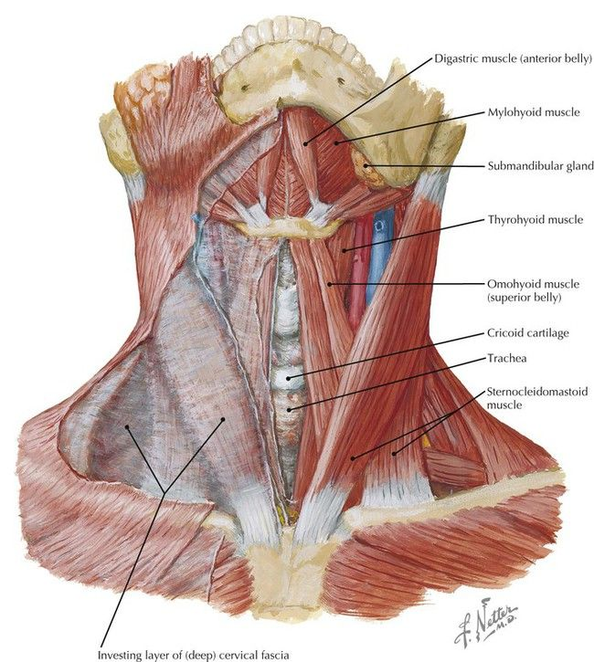
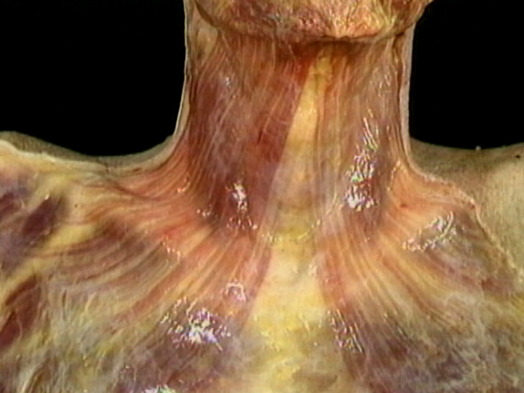
Platysma

Slide 4
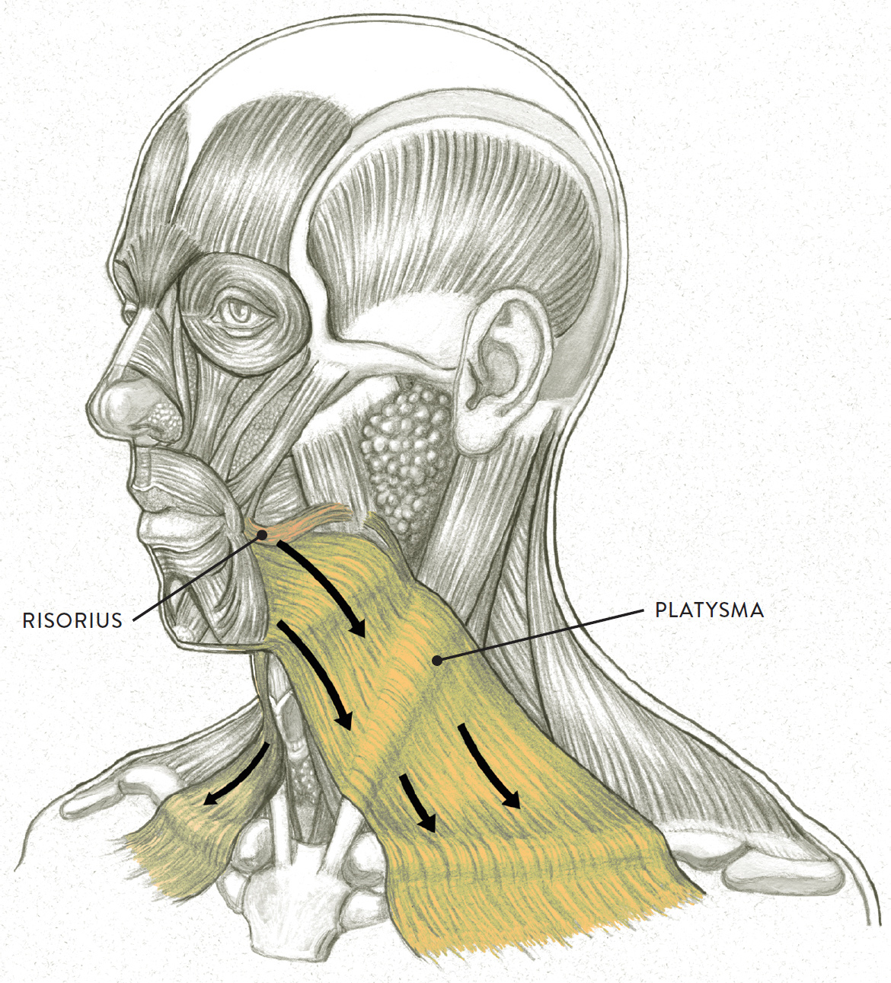

Slide 6
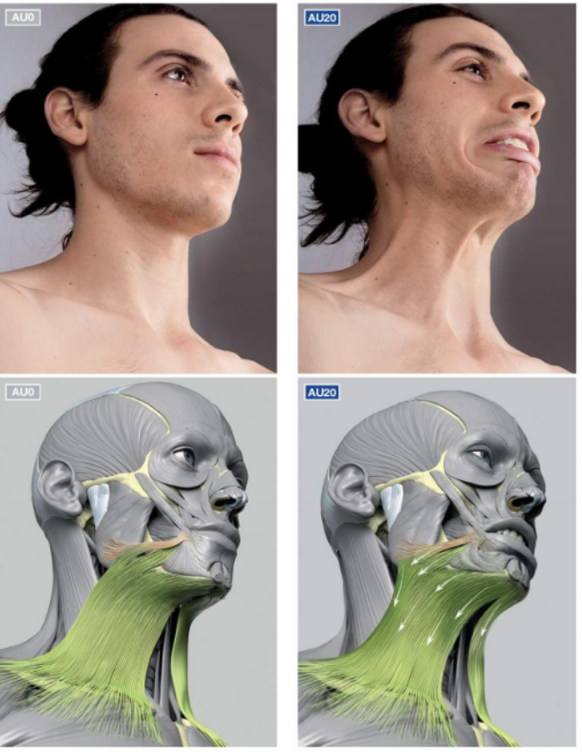
Cosmetic use of BTX in neck area
The platysma, together with the depressor anguli oris, exert a downward vector force decreasing the concavity between the jaw and neck, pulling the angle of the mouth and the lower lip downward.
The mentalis raises the tissues of the chin and the mentolabial sulcus, corrugating the skin of the chin.,
by relaxing the depressor muscles we can observe the elevation of the corner of the mouth, as a result of the action of their antagonists.

Slide 7
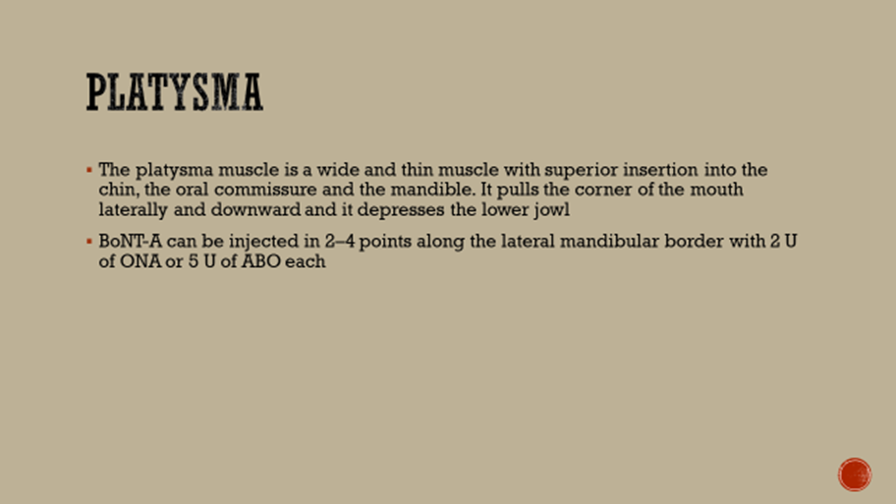

Slide 8
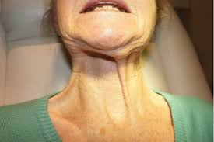
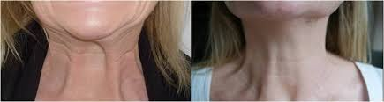
Platysma bands

Slide 9
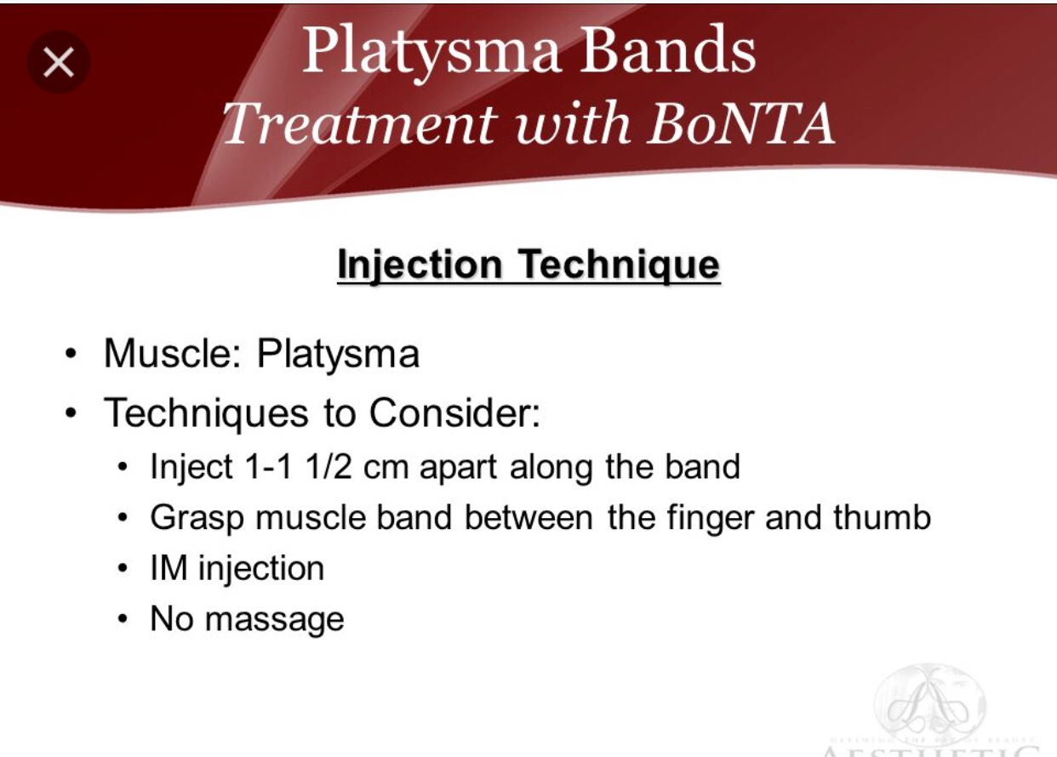
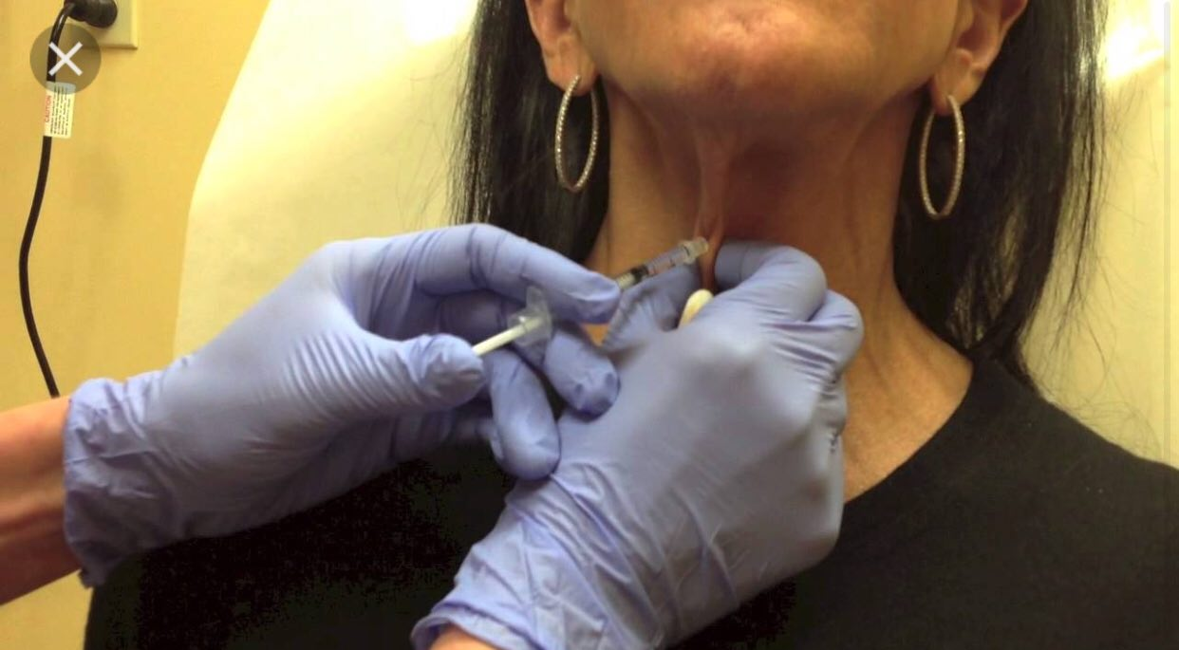
Platysmal band injection technique

Slide 10
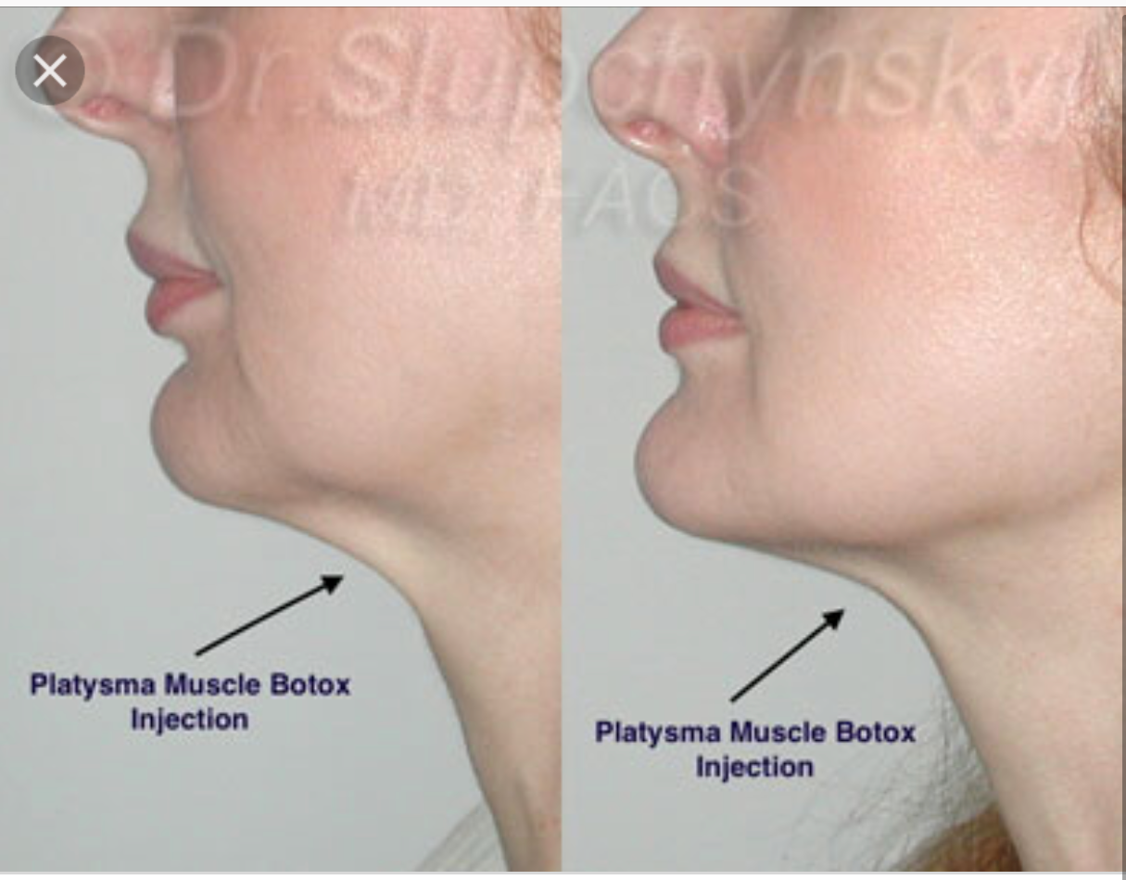

Slide 11
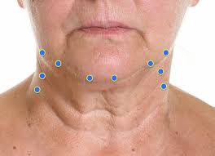
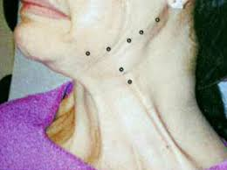
Nefertiti lift

Slide 12
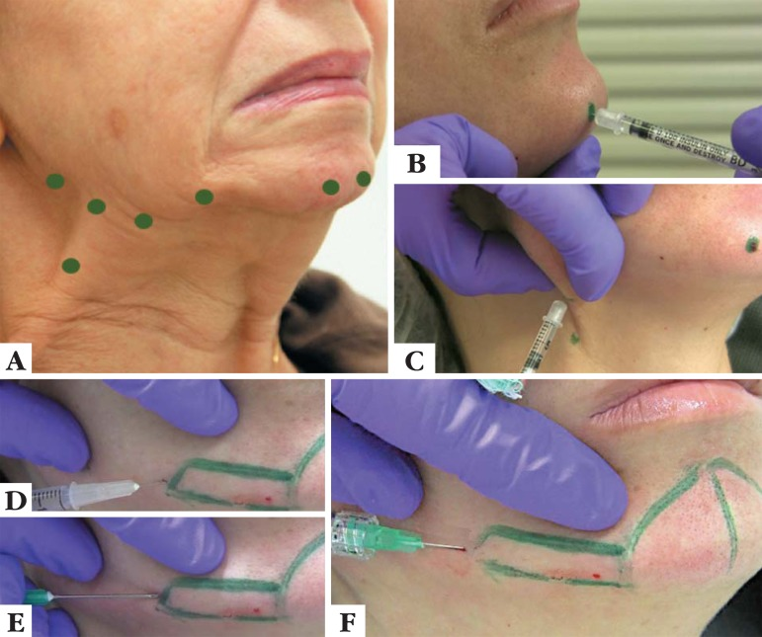
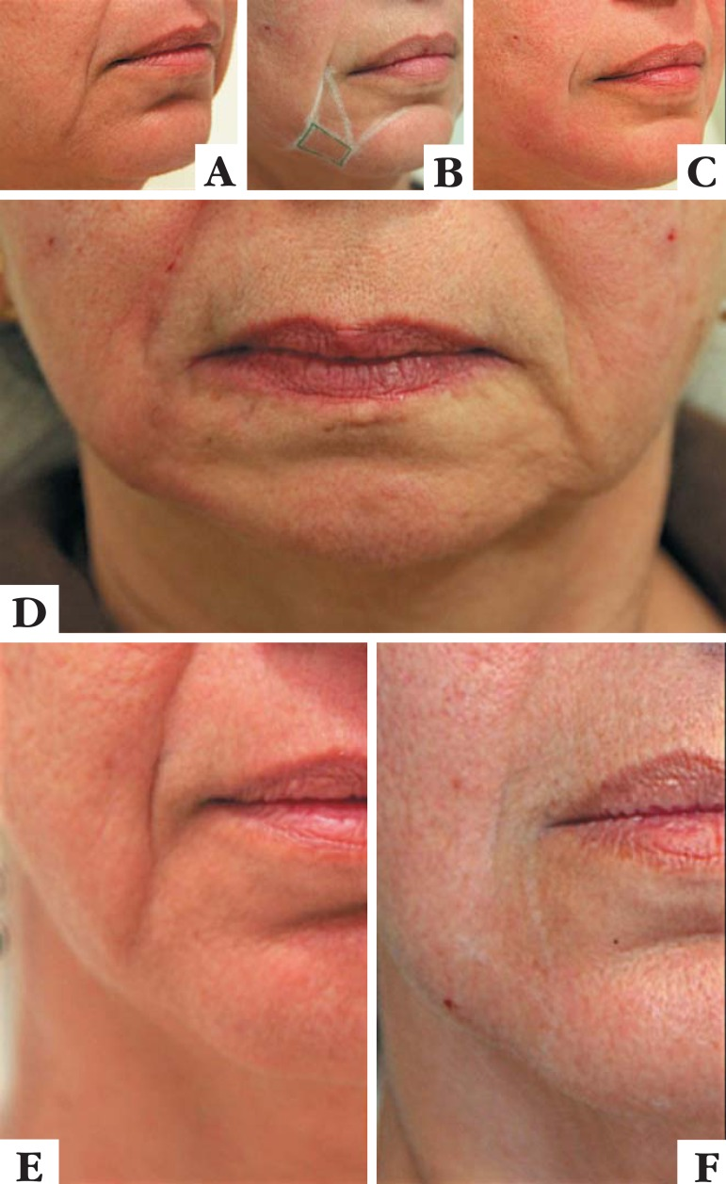

Slide 13
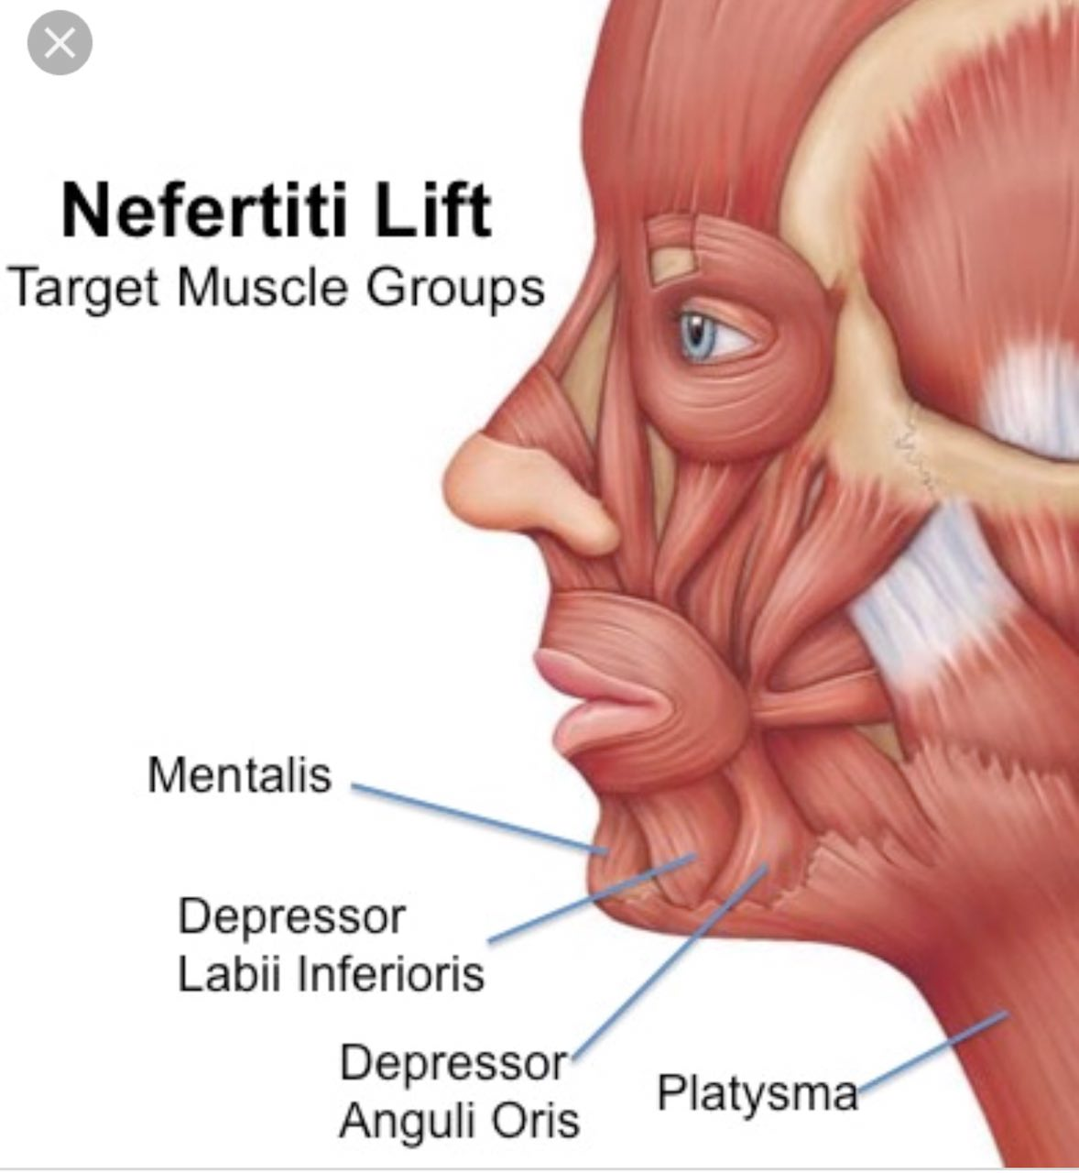

Slide 14
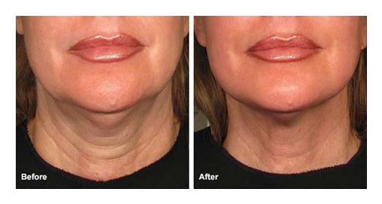

Slide 15
HYperHidrosis

Slide 16
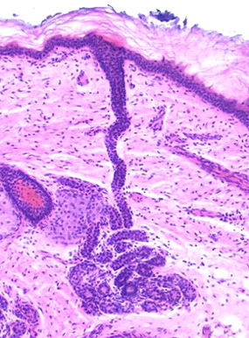
Eccrine glands

Slide 17
HYperHidrosis
Emotional vs thermoregulatory hyperhidrosis
a result of sympathetic overactivity
no structural defects of the eccrine glands
hyperhidrosis has a familial component, a possible genetic cause
Primary hyperhidrosis is due to abnormal central control of emotional sweating given that it affects the same body areas as those affected in emotional sweating (hands, feet, and axillae)

Slide 18
Focal ( essential) hyperhidrosis
Focal visible excessive sweating ≥6 months’ duration without apparent cause and at least two of the following:
■ Bilateral and relatively symmetric
■ Age of onset typically before age of 25 years
■ Cessation of sweating from the focal areas during sleep
■ Frequency of at least once per week
■ Positive family history
■ Sweating impairs daily activities

Slide 21
onabotulinum toxin A (onabotA), (BOTOX; Allergan, Irvine, CA) was approved by the U.S. Food and Drug Administration (FDA) in 2004 for the treatment of severe primary axillary hyperhidrosis in adults 18 years and older.
Off label use :the face or scalp, palms, soles, and inframammary and inguinal folds, with average efficacy duration of approximately 4 to 12 months

Slide 22
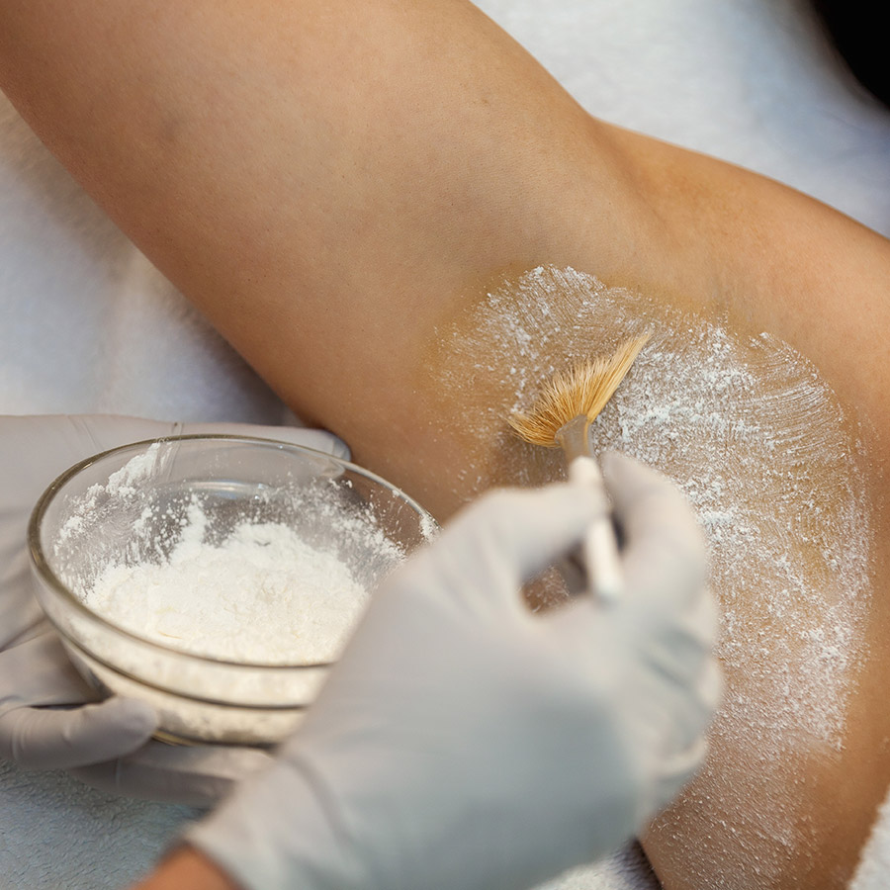
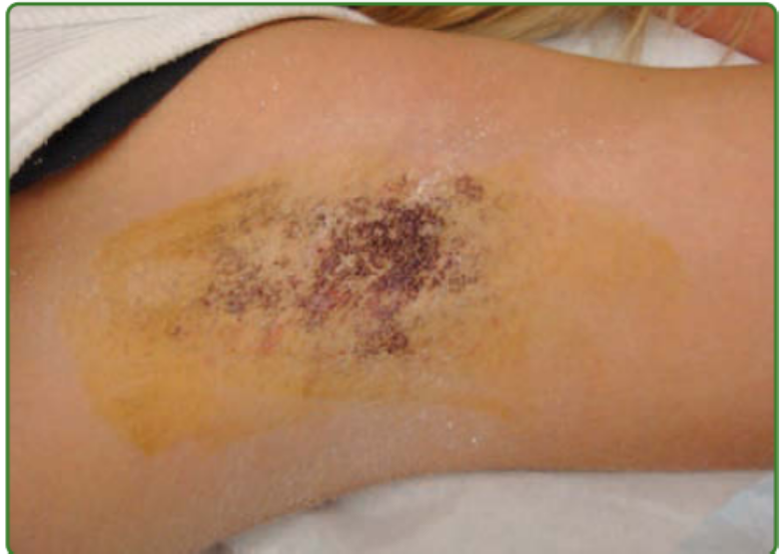
starch-iodine test

Slide 23
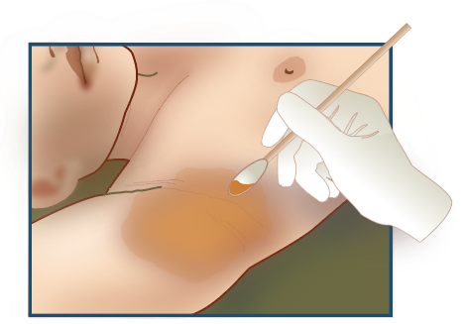
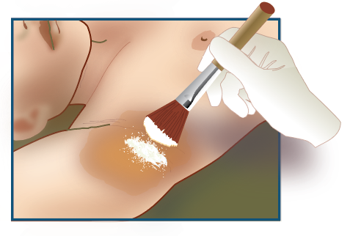
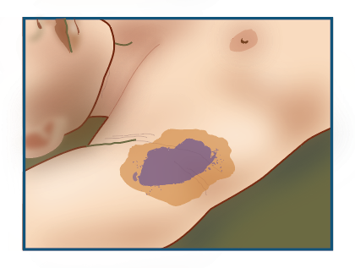
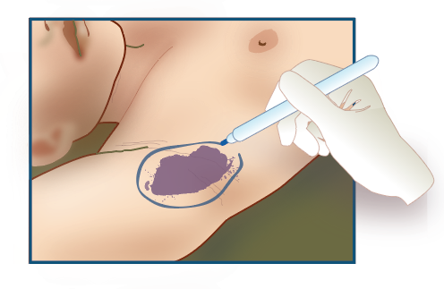
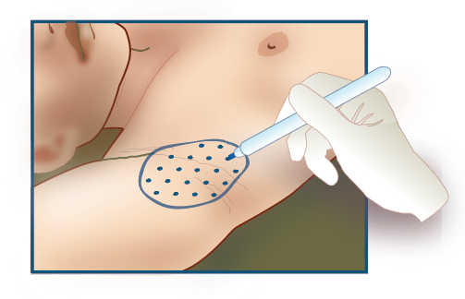
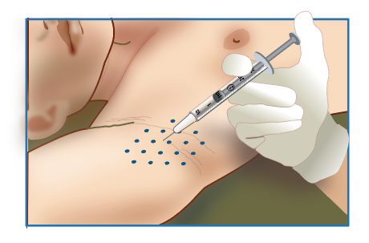

Slide 24
starch-iodine test
1. Clean and dry the axilla thoroughly and completely.
2. Paint the entire underarm area with an iodine solution or povidone-iodine, or with pre-moistened Betadine® swabs or swabsticks.
3. Allow the solution to dry. This will take a few seconds to approximately 1 minute
4. Dust the entire site evenly and very lightly with fine starch powder. Any commercially available cornstarch will suffice.
5. Wipe off any excess.
6. The presence of sweat will cause the mixture to turn a dark blue-purple color, making the location of sweating discernible. Wait approximately 10 to 15 minutes for the reaction to occur.
7. Outline or circle the area of excessive sweating with a surgical marker, or dermographic pen. The area may appear as one circle or oval, or it may appear as multiple areas, like “islands”.
8. Clean off excess starch and iodine solution.

Slide 25
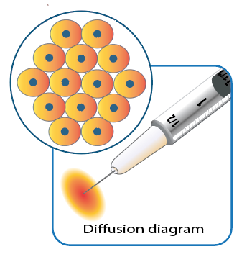
Injection technique
Use a surgical marker, to identify locations within the sweating area that are 1.5 cm apart from one another.
The sites should be positioned in a staggered manner rather than linear.
botulinumtoxinA diffuses under the skin to a diameter of approximately 2 cm,
it is recommended that physicians administer the injections at sites 1.5 cm apart in order to provide uninterrupted coverage and treatment of the area.

Slide 26
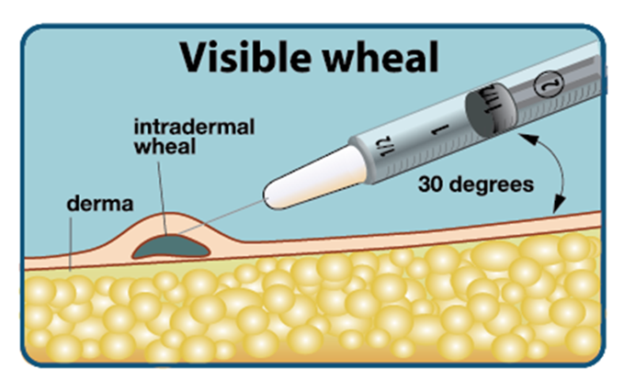
Injection technique
Inject intradermally
Because botulinum toxinA diffuses under the skin to a diameter of approximately 2 cm, it is recommended that physicians administer the injections at sites 1.5 cm apart in order to provide uninterrupted coverage and treatment of the area

Slide 27
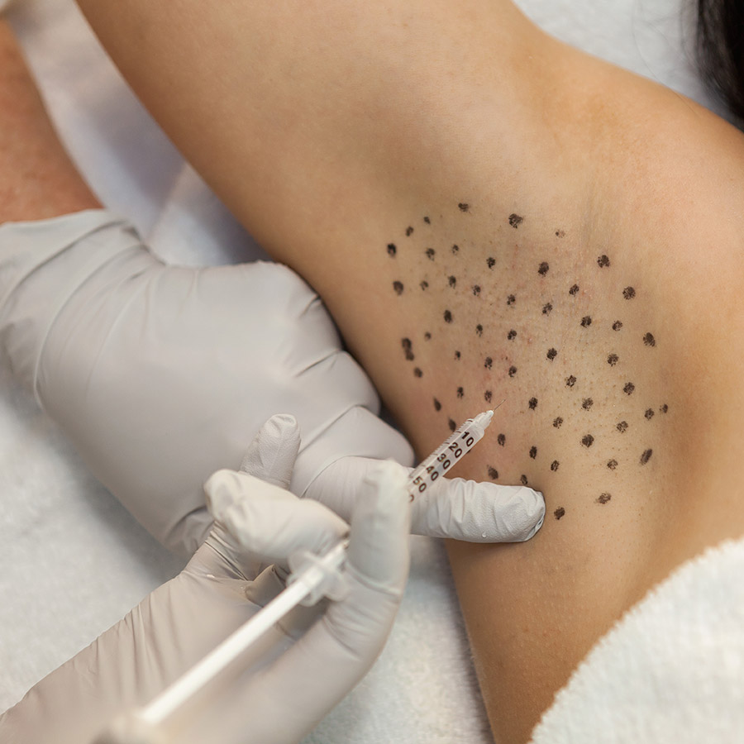
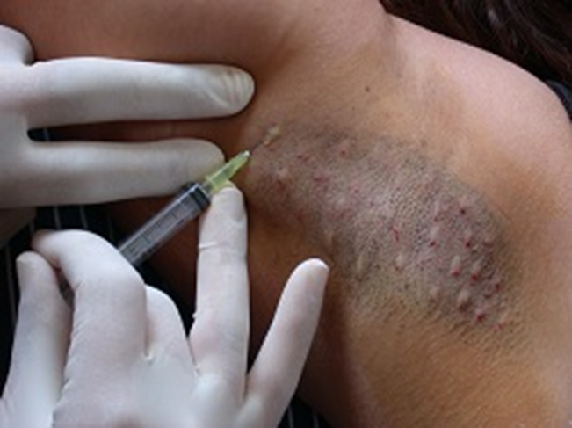
Intradermal toxin injection

Slide 28
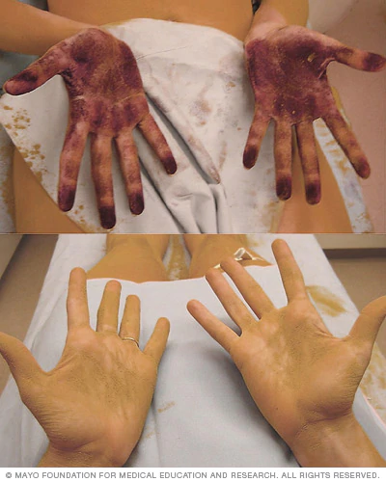
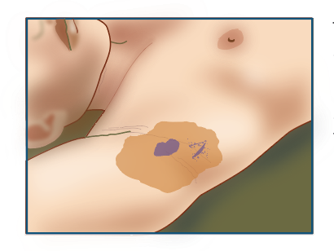
Starch iodine test for touch up
Follow up for reinjection

Slide 29
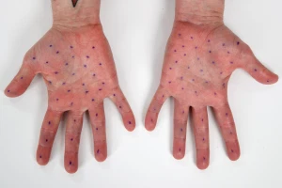
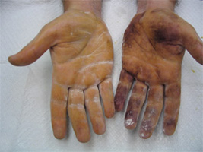
Plantar hyperhidrosis

Slide 30
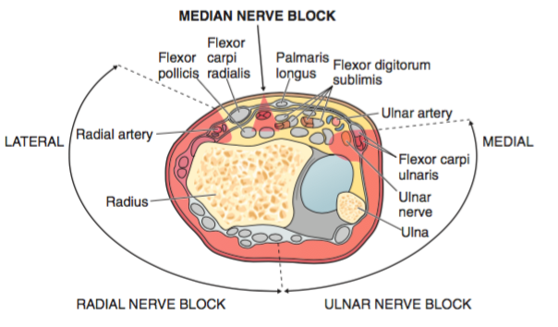
Wrist block

Slide 31
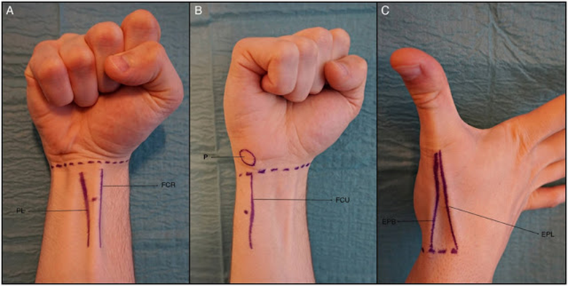
Wrist block

Slide 32
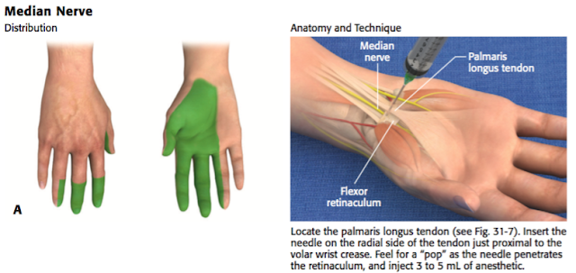
Median nerve block

Slide 33
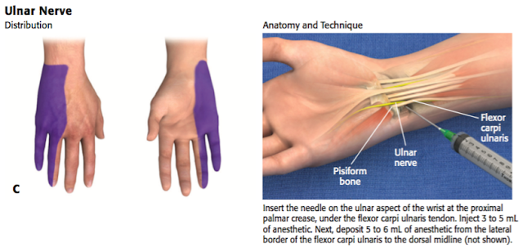
Ulnar nerve block

Slide 34
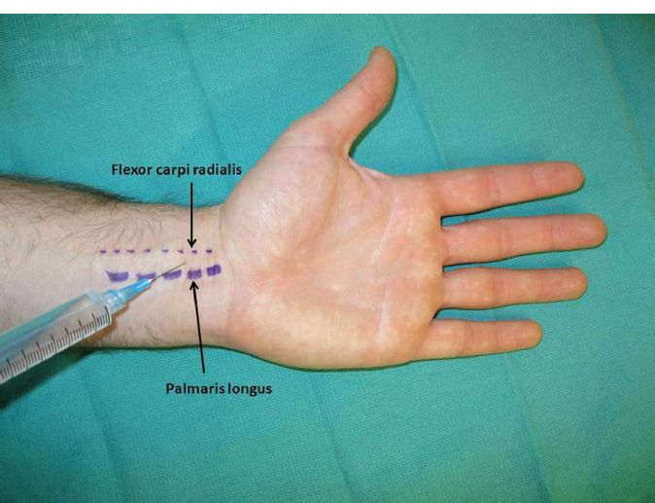
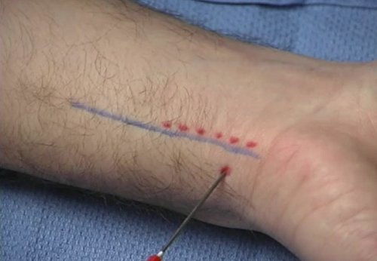
Median n
Ulnar n

Slide 35
Craniofacial hyperhidrosis
It is more common in men than women
most frequently involves the forehead, but can affect other areas.
There are four main patterns: ophiasis, diffuse or whole scalp, upper lip and Frey syndrome.2
_

Slide 36
Frey syndrome
unilateral gustatory sweating and flushing of the face postparotidectomy
result from aberrant regeneration of damaged postganglionic parasympathetic fibres that previously innervated salivary glands, forming anastomoses with the severed postganglionic sympathetic fibres to sweat glands
secondary to misdirected regeneration of postganglionic nerve fibers of both the auriculotemporal and greater auricular nerves.

Slide 37
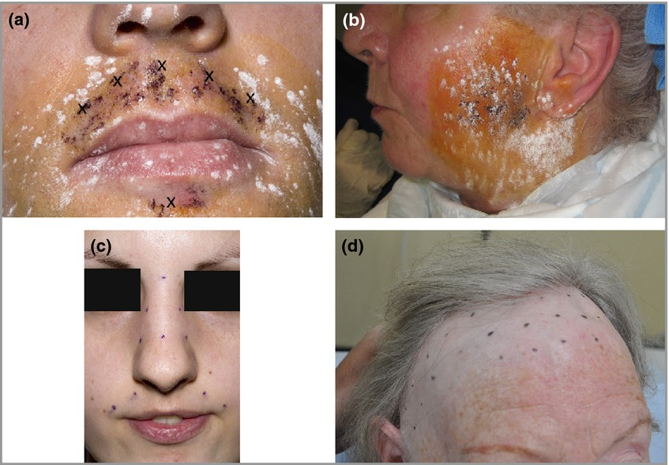
botulinum toxin using a dose of 1–2 units per injection

Slide 38
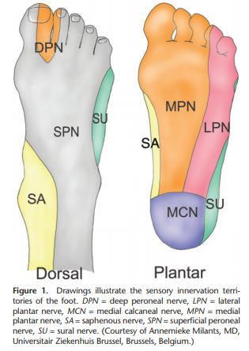
Tibial nerve: It divides into lateral and medial plantar nerves just inferior to the medial malleolus.
Location: posterior to medial malleolus
Sensory: plantar surface of the foot
Motor: flexes the toes

Slide 39
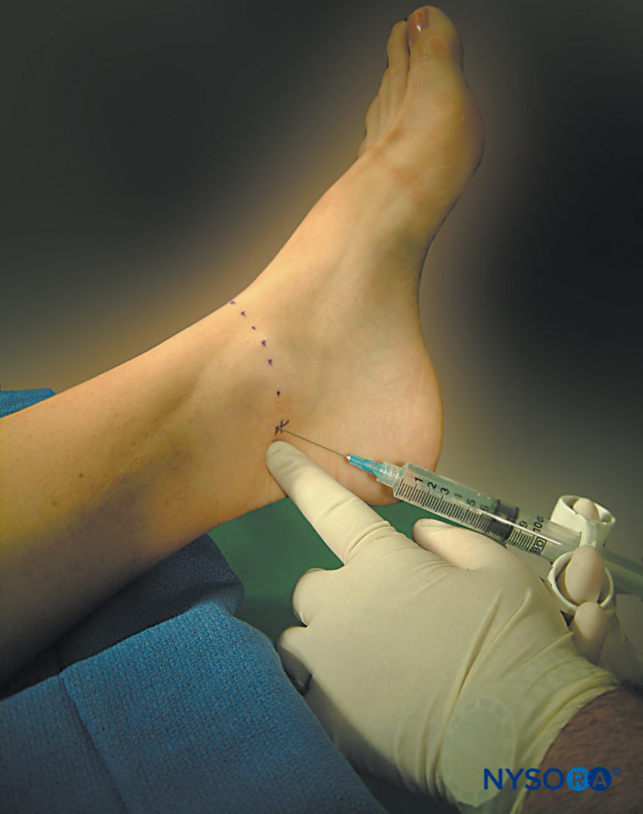
Post Tibial nerve block
Perimaleolar approach
a 1.5-in., 25-gauge needle is inserted just posterior to the pulse of the posterior tibial artery behind the medial malleolus,
if it cannot be palpated, mid-way between the Achilles tendon and the posterior aspect of the medial malleolus
The needle is directed toward the tibia at a 45-degree angle to contact bone. The needle is then withdrawn a few millimeters, and after negative aspiration, 5 mL of local anesthetic is injected

Slide 40
Dosage
Abo/BTX Dysport
Ona / BTX Botox
100-150 UNIT / AXILLA
150-250 UNIT/ HAND
50-75 UNIT /AXILLA
50-100 unit / HAND

Slide 41
Toxin and Saline versus
Toxin and Anesthetic
Time of onset of sweat production, duration of effect and subjective percentage of mean decrease in sweating were similar for both groups.
Pain score during the procedure was significantly lower in the axilla treated with lidocaine-reconstituted solution
NO SIGNIFICANT DIFFERENCE BETWEEN Abo and Ona BTX

Slide 42
CONTRAINDICATIONS
Absolute contraindications for injection with BoNT include pregnancy , skin infections and allergies to any of the ingredients in BoNT formulations.
Relative contraindications include illnesses resulting in muscle weakness (ALS, Lou Gehrig’s), dysphagia (Myasthenia Gravis or Lambert Eaton Syndrome) or respiratory compromise

Slide 43
WITH REPEATED INJECTIONS USUALLY THE SWEAT PRODUCTION NEVER RETURNS TO THE BASELINE RATE

Slide 44
Complications
AXILLA TREATMENT :
COMPENSATORY HYPERHIDROSIS IN HANDS OR THIGHS
Cold like symptoms
pruritus
CRANOFACIAL:
drooping of upper lip
loss of rhytides on her forehead and mild brow ptosis
PALMAR:
transient and minor handgrip weakness( Lasting 2-5 weeks)
PLATYSMA
Dysphagia
bruising

Slide 45
BTX in Hypertrophic Scar Treatment
2,5 -5 IU/cm3 , 3 sessions, repeated every 4- 8 weeks , not exceeding 100 IU/session
significant decrease in erythema, itching, and pliability of the scar
No atrophy or telangiectasia
Mechanism
BTX has been shown to inhibit the proliferation of fibroblasts derived from hypertrophic scar
suppress the expression of transforming growth factor (TGF)-β1, collagen I and III, α-smooth muscle actin and myosin II protein in keloid fibroblasts
immobilize the local muscles of a scar and reduce skin tension caused by the muscle pull

Slide 46
BTX in Scar Prevention
blocking acetylcholine neurotransmitter release from peripheral nerves, BTX allows near-complete elimination of dynamic muscle tension on the healing wound
direct inhibitory effects of BTX on fibroblasts and TGF-β1 expression
The anti-inflammatory effect of BTX and its action of the cutaneous vasculature calms down the inflammatory phase (immediate to 2–5 days)
optimal to inject BTX intraoperatively or shortly (preferably within 10 days) after the surgery
15-60 units injected

Slide 47
BTX in Rosacea and Facial Flushing
MECHANISM
blockade of acetylcholine release from autonomic peripheral nerves of the cutaneous vasodilatory system
BTX inhibits the release of inflammatory mediators such as substance P and calcitonin gene-related peptide
additional benefits as it also improve the fine lines and wrinkles by diminishing the pull of the facial depressors.
DOSAGE
6.2 IU of abo-BTX per injection point, 40 points over the face, chest, neck, and scalp
15–45 IU of BTX was injected to the face for rosacea

Slide 48
BTX in Postherpetic Neuralgia
Mechanism:
The peripheral effects of BTX injection come through the inhibition of neuropeptide release from the peripheral nociceptive nerves
BTX has been suggested to exert central nervous system (CNS) effects through axonal transport to the CNS after peripheral application
subcutaneous injections into the affected area, specifically the area demonstrating evidence of tactile allodynia, with single-use tuberculin syringes (1 mL) within 1.0–2.0 cm radius of skin

Slide 49
Further reading references
Toxins 2013, 5, 821-840; doi:10.3390/toxins5040821

