Slide 1
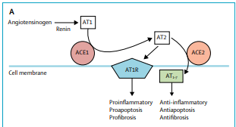
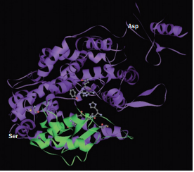
Angiotensin – Converting Enzyme ACE, ACE2
Dr. F. Ahmadi
Professor Of Nephrology TUMS

Slide 2
Renin- angiotensin system(RAS)
The importance of the renin–angiotensin system (RAS) in the regulation of normal physiology and pathogenesis of cardiovascular disease is well established
Renin is the rate limiting enzyme in the RAS, whereas angiotensin II is the major effector molecule

Slide 3
Overview of the renin-angiotensin system
Curr Opin Nephrol Hypertens 2014, 23:480–486

Slide 4
Current view of the renin–angiotensin system
Current Opinion in Nephrology and Hypertension 2007, 16:122–128

Slide 5
Schematic representation of the renin-angiotensin system (RAS)
International Journal of Hypertension Volume 2012

Slide 6
Journal of Endocrinology (2013) 216, R1–R17

Slide 7
ACE2
ACE2 is an 805-amino acid type I integral membrane glycoprotein and it has an N-terminal extracellular catalytic domain, a small transmembrane segment and a short C-terminal intracellular tail
ACE2 it functions as a carboxypeptidase, rather than a dipeptidase, and ACE2 activity is not antagonized by conventional ACE inhibitor

Slide 8
ACE2
The ACE2 catalytic efficiency for angiotensin II is >300 times that for angiotensin I
ACE2 can also hydrolyse other bioactive peptides, such as apelin-13, β-casomorphin, dynorphin A 1–13, and ghrelin
The pro-inflammatory kinin, DesArg9-Bk, is efficiently hydrolysed by ACE2 but not by ACE

Slide 9
ACE and ACE2 structure

Slide 10
Metabolic similarities and differences between the two ACEs of the RAS
Exp Physiol 93.5 pp 519–527

Slide 11
The vasoconstrictor/proliferative and the vasodilator/antiproliferative actions of the RAS mediated by Ang II and Ang(1–7), respectively, depend on the ACE/ACE2 ratio balance
Exp Physiol 93.5 pp 519–527

Slide 12
Effect of ACE2
Blood-pressure regulation
Cardiac remodelling and heart failure
Atherosclerosis
Cerebral vessels and ischaemic stroke
Chronic Kidney Disease (CKD)
Diabetes
Lung
The gut
Immune system

Slide 13
ACE2 in kidney
In the kidney, ACE2 is primarily localized in the apical membrane of the epithelial cells in the proximal tubules, where it colocalizes with ACE
ACE2 is also present in the glomerular podocytes, mesangial cells, and renal vasculature
Glomerular ACE, in contrast, is localized in endothelial cells

Slide 14
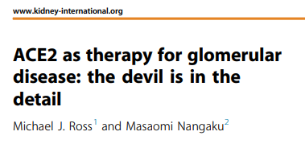
Genetic deletion of ACE2in a mouse model of unilateral ureteral obstructive enhanced renal fibrosis and inflammation, which were associated with the activation of intrarenal trans-forming growth factor-b/Smad2/3 and nuclear factor-kB signaling pathways. ACE2 knockout also aggravated inflammation and oxidative stress in a model of acute kidney injury of ischemia reperfusion
Kidney International(2017)91,1269–1282

Slide 15
ACE2 as therapy for glomerular disease: the devil is in the detail
Decreased glomerularACE2 may increase intraglomerular Ang II and contribute to the progression of diabetic kidney disease, where as an increase in ACE2 in the tubules may serve as a defensive mechanism via its vasodilatory and natriuretic effects in the early stage of diabetes.
Podocyte-specific over expression of humanACE2 attenuated the development of experimental diabetic nephropathy
Kidney International(2017)91,1269–1282

Slide 16
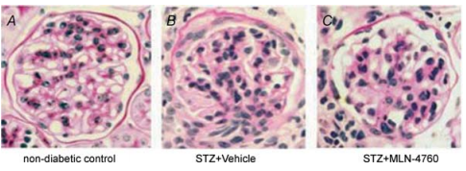
Genetic ACE2 ablation in male mice (ACE2−/y ) leads to age-dependent development of glomerular mesangial expansion with increased deposition of fibrillar collagens I/III and the extracellular matrix protein fibronectin
Glomerular vascular injury was limited to the microvasculature of the glomerular capillary tuft and the preglomerular afferent arteriole, with arteriolar hyalinosis and micoraneurysm formation
Exp Physiol 93.5 pp 549–556

Slide 17
The rationale for ACE2 treatment was based on reduced levels of ACE2 in patients with renal disease and in experimental models, including in Col4a3–/– mice, which spontaneously develop Alport
rACE2 reduce TGF-b, inflammation, inflammatory cytokine expression and macrophage infiltration, mitogen-activated protein kinase signalling
Nature Reviews Nephrology| Published online 13 Mar 2017

Slide 18
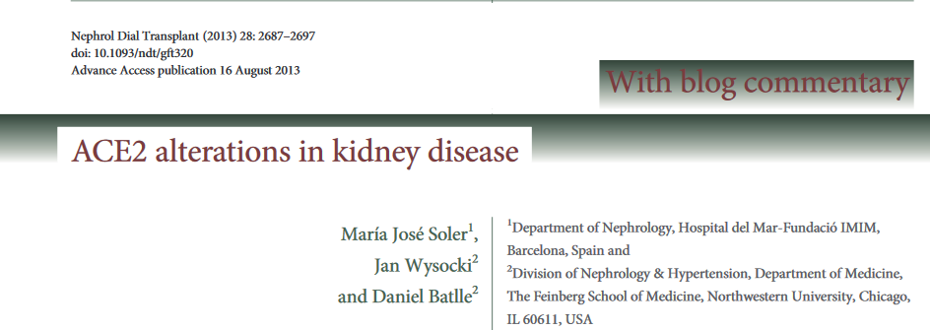

Slide 19
In summary, there appears to be a pattern of decreased glomerular ACE2 and increased ACE expression in diabetic kidney that may increase intraglomerular Ang II and contribute to the progression of DN. In contrast, in whole kidney cortex ACE is decreased and ACE2 increased

Slide 20
Glomerular angiotensin-converting enzyme 2 (ACE2) and ACE in diabetic mice
ACE and ACE2 go in opposite directions, and that at the glomerular level there is an increase in ACE but a decrease in ACE2 in diabetic mice.Overall, studies using kidney biopsies from patients with type 2 diabetes have similarly shown that ACE is increased whereas ACE2 is decreased at the glomerular level
Kidney International(2012)81, 520–528

Slide 22
In summary
Delivery and stimulation of ACE2 or stimulation of ACE2 alone are putative therapeutic approaches for treatment of kidney injury, at least in part by exerting beneficial effects on renal function and attenuating kidney inflammation and fibrosis

Slide 23
ACE2 and Angiotensin1-7
Angiotensin-converting enzyme (ACE) 2 and its product angiotensin 1–7 are thought to have effects that counteract the adverse actions of other, better-known renin–angiotensin system (RAS) components
Numerous experimental studies have suggested that ACE2 and angiotensin 1–7 have notable protective effects in the heart and blood vessels

Slide 24
Overview of the ACE2–Ang 1–7 pathway
Jiang, F. et al. Nat. Rev. Cardiol. 11, 413–426 (2014)

Slide 25
Potential effects of ACE2 and Ang 1–7 on blood-pressure regulation
Jiang, F. et al. Nat. Rev. Cardiol. 11, 413–426 (2014)

Slide 26
Effects of human recombinant ACE2 (hrACE2) onangiotensin II (Ang II) and Ang-(1–7) and systolic bloodpressure (SBP)

Slide 27
Experimental findings for the effects of ACE2 on BP
Jiang, F. et al. Nat. Rev. Cardiol. 11, 413–426 (2014)

Slide 28
Experimental findings for the effects of Ang1-7 on BP
Jiang, F. et al. Nat. Rev. Cardiol. 11, 413–426 (2014)

Slide 29
Protective effects of ACE2 and Ang 1–7 on atherosclerosis and resultant myocardial infarction and stroke
Jiang, F. et al. Nat. Rev. Cardiol. 11, 413–426 (2014)

Slide 30
Potential protective effects of ACE2 and Ang 1–7 on pathological cardiac remodelling and heart failure
Jiang, F. et al. Nat. Rev. Cardiol. 11, 413–426 (2014)

Slide 31
Beneficial effects of ACE2 and Ang 1-7 on insulin resistance and diabetes
Angiotensin 1–7 facilitates glucose uptake by upregulation of glucose transporter type 4 expression,
Jiang, F. et al. Nat. Rev. Cardiol. 11, 413–426 (2014)

Slide 32
Effects of recombinant angiotensin-converting enzyme 2 administration and angiotensin-converting enzyme activation in experimental kidney disease
Curr Opin Nephrol Hypertens 2017, 26:000–000

Slide 33
Drugs targeting the renin-angiotensin system
Several animal studies demonstrated that drugs targeting the ACE2/Ang-(1-7)/Mas axis have similar effects as the widely used ARBs and ACE inhibitors
Curr Opin Nephrol Hypertens 2014, 23:480–486

Slide 34
Conclusions
ACE2 is a crucial enzymatic regulator of angiotensin peptide metabolism, important for renal and cardiovascular health and modulation of disease phenotypes
New pharmacological interventions targeting ACE2 are expected to be useful in clinical treatment of cardiovascular disease, especially those associated with over activation of the conventional RAS

