Slide 1
Introduction
The importance of renin and RAS in the pathogenesis of Cardiovascular disease was only fully realized in the 1970
Increasing evidence indicate that PA prevalence is 5 to 10%
To select physiologically individualized therapy for resistant hypertension

Slide 2
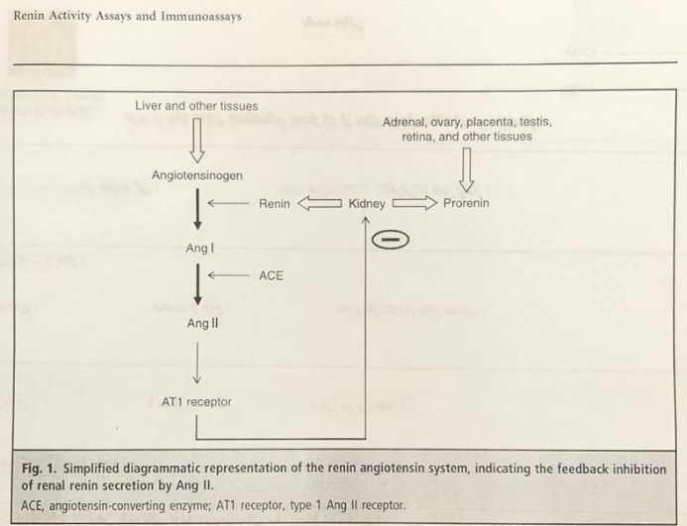

Slide 3
History
Tigerstedt : 1898
Goldbladd: 1935

Slide 4
Renin and pro-renin
Human renin gene spans 11. 7kb DNA and consists of 10 exons, it is located within q32 band of chromosome 1
Renin is synthesized as a pro-renin, with a 43 KD polypeptide and several KD of oligosaccharide side chains
Pro-renin secreted rapidly and intact
Packaged into immature granules and processed into renin

Slide 5
Renin
Aspartic protease is synthesized as the inactive zymogen pro-renin
Renal JG cells are the only known site of production for renin
Consists of two homologous lopes with a cliff in between that Contains two active site catalytic aspartic residues
Renin as highly specific and only cleaves angiotensinogen

Slide 6
Angiotensinogen
It synthesized mainly by liver (452 amino acid)
Concentrations are increased during pregnancy, glucocorticoid excess and estrogen
Concentration are decreased in liver disease and high renin concentration

Slide 7
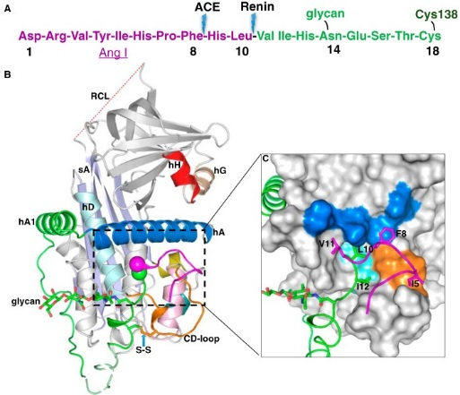

Slide 8
Pro-renin
It is a 43 KD polypeptide and several KD of oligosaccharide side chains
It is produced by kidney and a number of extra renal tissues
Plasma concertation of pro-renin are 10 fold higher than renin
More than 98% of it is in a closed conformation in which pro-segment masks the active site
Pro-renin account for up to 90 percent of circulating renin
It is elevated in diabetic patients
Pro-renin can be activated at a low T, PH and binding to its receptor

Slide 9
Measurement of renin
Direct plasma renin concentration
Plasma renin activity
Angiotensinogen -> Ang II
Expressed as ng/ml/h
Which one is better ? -> angiotensinogen
-> chemiluminescencn

Slide 10
Normal values
Normal PRA is 1 to 4 ng/ml/per hours
Active renin concentrations are 8 to 35 mu/L
It depends on Na diet

Slide 11
Control of renin secretion
Angiotensin II
Sodium intake

Slide 12
Factors that affect renin
Sodium intake
Age
Gender
Menstrual phase and pregnancy
Time of day
Posture
Medication
CKD
Race

Slide 13
Drugs
Β – blockers and clonidine can rise the ARR
Diuretics, ACE- IS, dihydropyridins CCBS and ARBS reduce the ARR
Few data are available on α – blockers
Prazocin and doxazosin do not appear to have a significant effect on ARS

Slide 14
Interpretation in adrenal disease
Low renin level
Primary aldosteronism
Patients with 11 beta or 17 alpha hydroxylase deficiency
Primary glucocorticoid resistance
Patients with DOC
Ectopic ACTH syndrome
Normal renin level
Secondary adrenal insufficiency
Cushing's syndrome
High renin
Primary adrenal insufficiency
Congenital adrenal hyperplasia

Slide 15
Interpretation in non adrenal condition
Low renin level
Liddle's syndrome
Deficiency of 11 β – hydroxysteroid dehydrogenase type 2
Mutations of the MR gene
Familial hyperkalemic hypertension
High renin level
Reno vascular hypertension
Pseudohypoaldosteronism type 1
Malignant hypertension
Bartter and Gitelman
Heart failure, hepatic cirrhosis, nephrotic syndrome

Slide 16
Inhibition of renin
Peptide analogues of angiotensinogen
Peptidomimetic compounds
Non-peptide like compounds
Aliskiren

Slide 17
Pro-renin receptor
A single transmembrane receptor (350 amino acid)
Receptor for both pro-renin and renin
It causes a fourfold increase in renin ability
Binding pro-renin to PRR causes conformational change
Activates various signaling pathways
It helps to localize the action of renin and pro-renin to the cell surface

