Slide 1
Principles of ICS for Viral
Infections &Respiratory Care in ICU
(COVID-19)
Seyed Hossein Ardehali MD,FCCM
Associate Professor of Critical Care Medicine,
Shahid Beheshti University of Medical Sciences

Slide 2
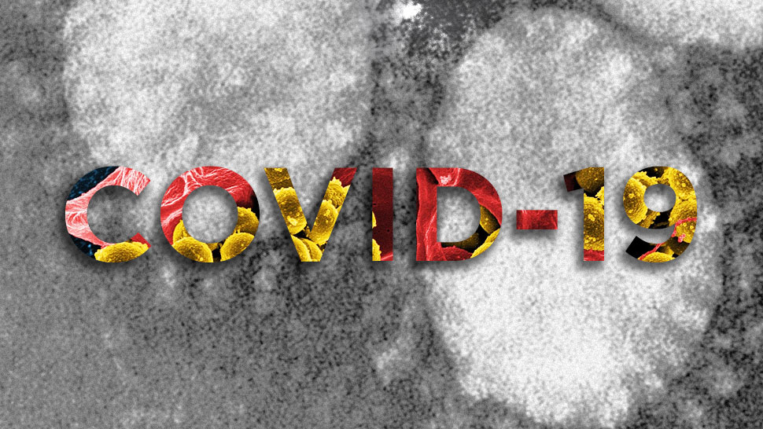

Slide 3

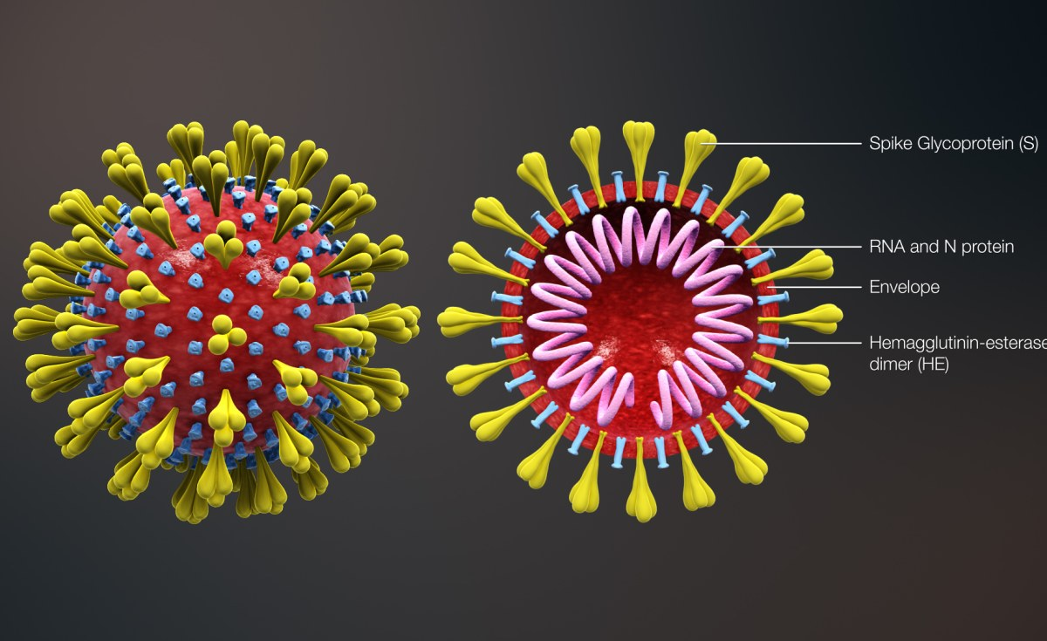

Slide 4


Slide 5



Slide 6
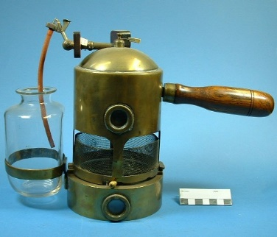

Slide 7
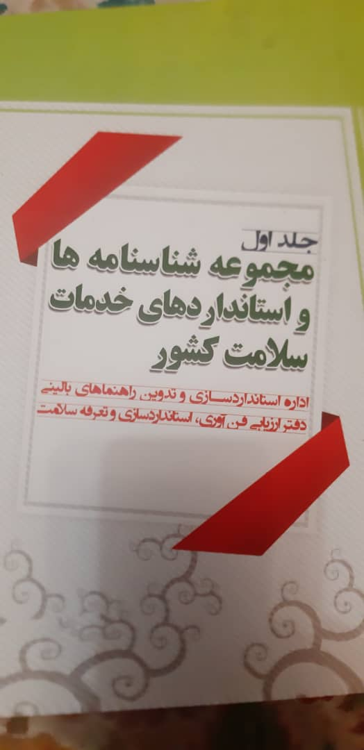


Slide 8
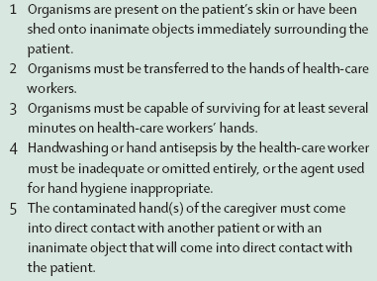
5 Essential Steps for Cross Transmission

Slide 9
ICU patients
Sickest patients (multiple diagnoses, multi-organ failure, immunocompromised, septic and trauma)
Move less
Malnourished
More obtunded (Glasgow coma scale)
Diabetics and Heart failure,…

Slide 10
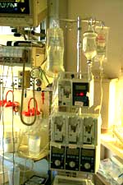
ICU Care is Invasive
More invasive lines and procedures including surgeries
Longer length of stay
More IV and parenteral drugs
More tube feeding and Parenteral nutrition
More ventilation

Slide 11
ICU : Factors that increase cross-infections
Low Hand washing facilities
Patient close together or sharing rooms
Understaffing
Preparation of IVs on the unit
Lack of isolation facilities
No separation of clean and dirty AREAS
Excessive antibiotic use
Inadequate decontamination of items & equipments
Inadequate cleaning of environment

Slide 13


Slide 14

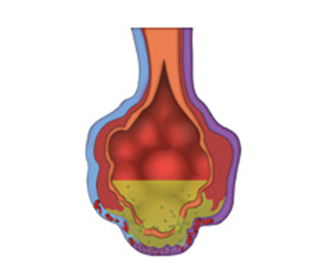

Slide 15
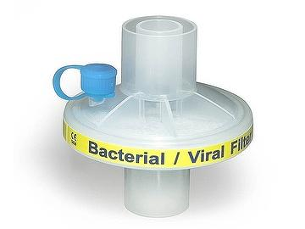
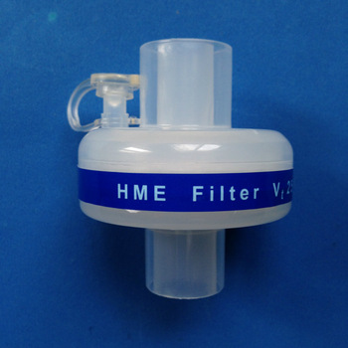
Filters

Slide 16
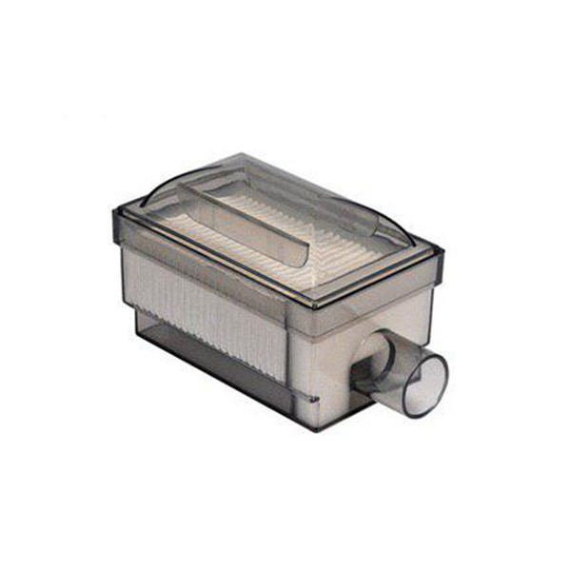


Slide 17
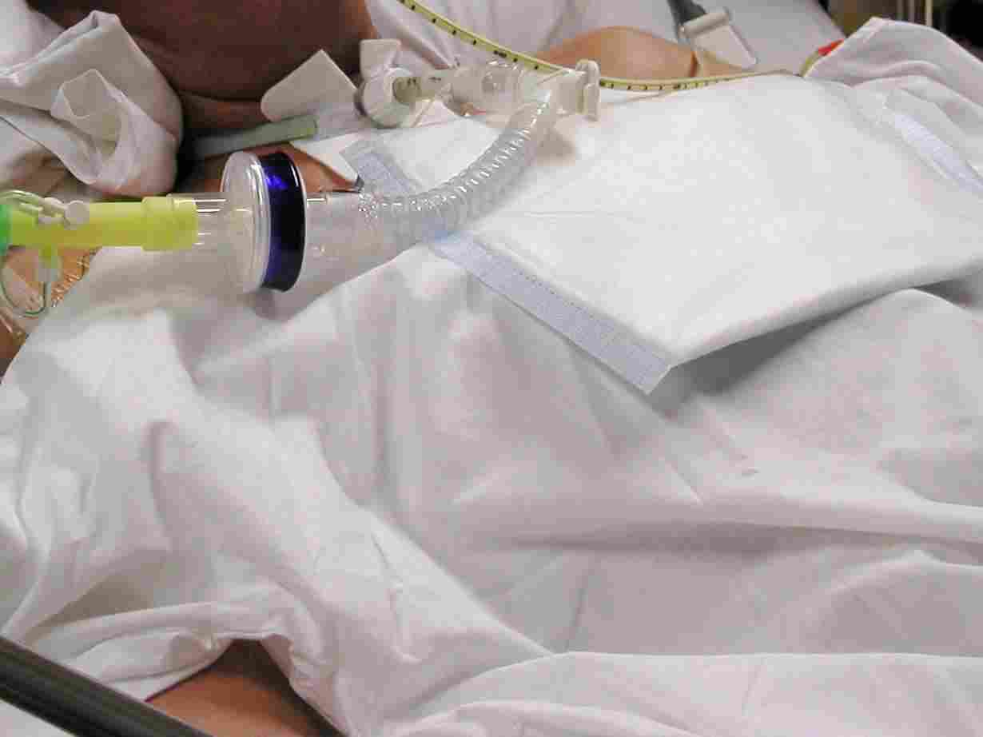

Slide 18
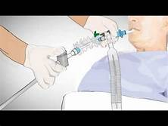
Closed Suction System (CSS)

Slide 19
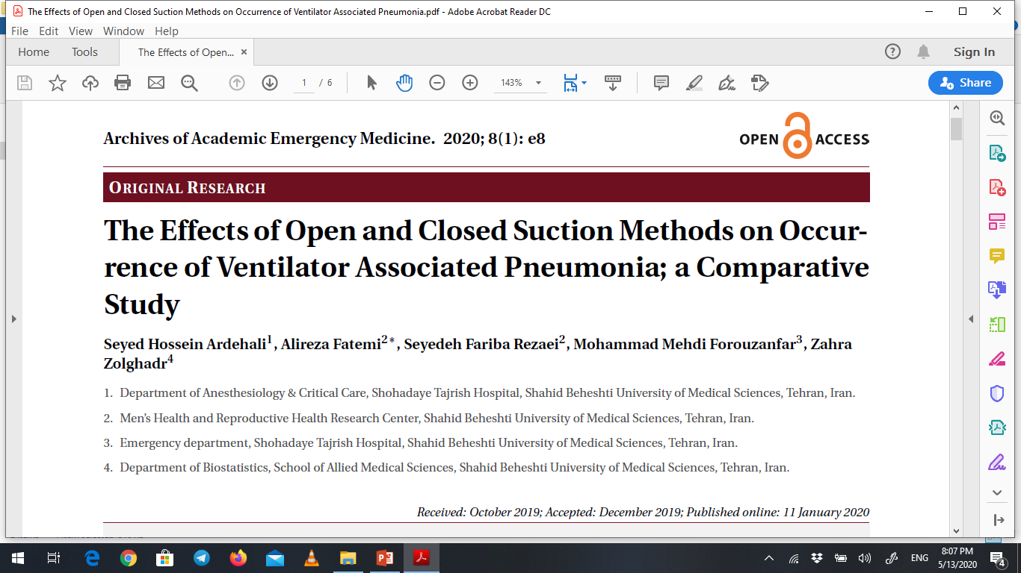

Slide 20


Slide 21

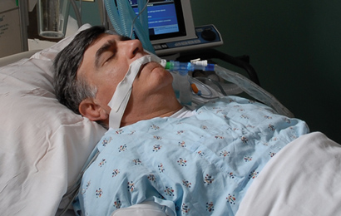

Slide 22
Critical care bundle therapy
A “Bundle” is a structured way to improve patient care and outcomes by following straightforward, well‑defined, checklist‑based set of evidence‑based practices and it is an essential part of surveillance for infection in ICUs.
The bundles which are prepared as an objective, bedside practice‑based approach with 3–5 elements in each have shown significant reduction in HAIs and improvement in patient outcomes.

Slide 23
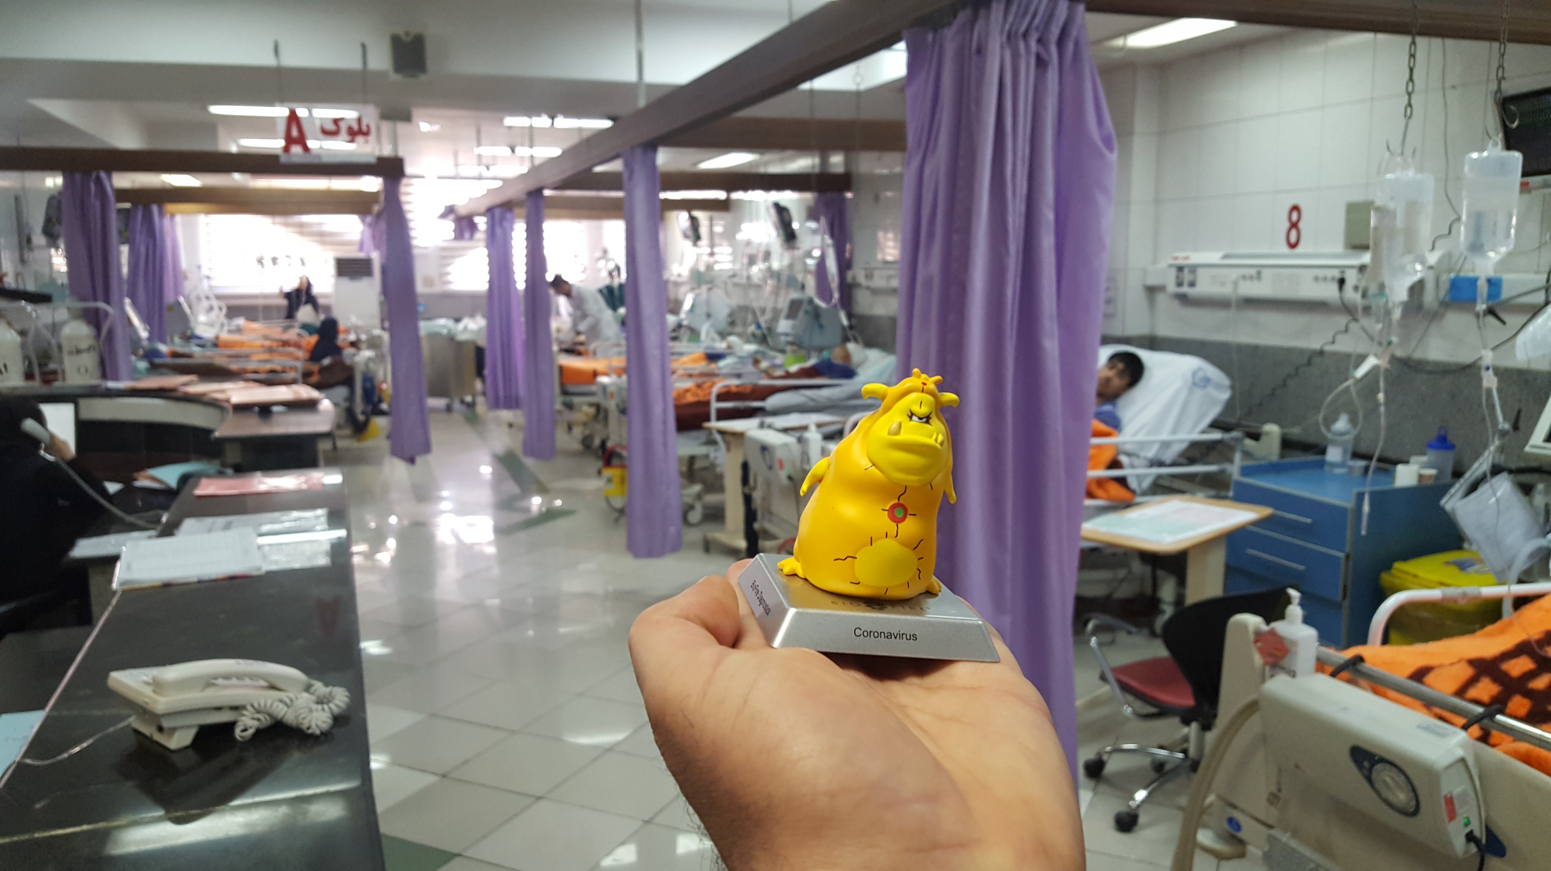

Slide 25
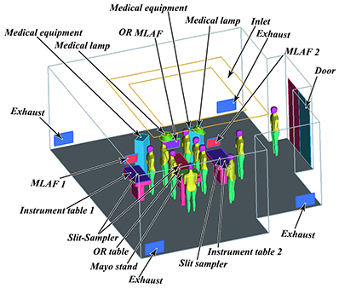
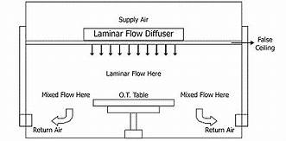

Slide 27
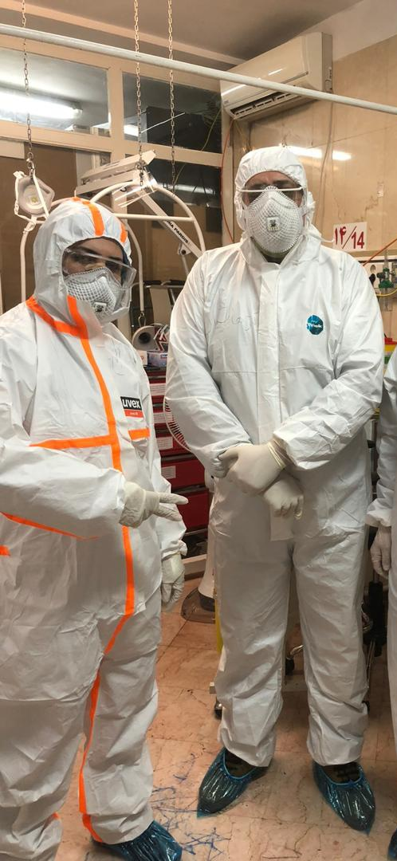

Slide 28
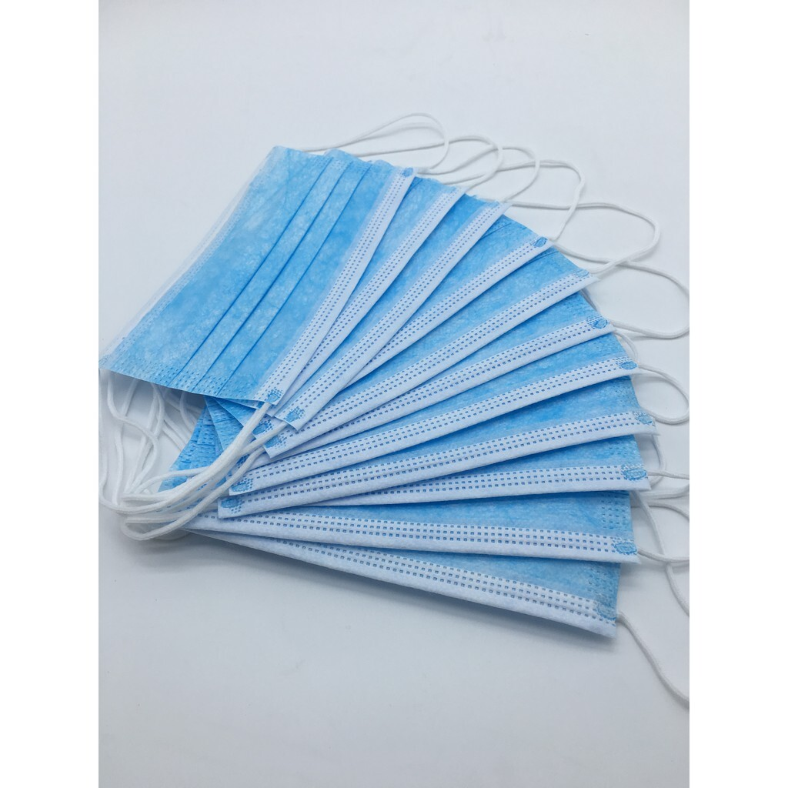
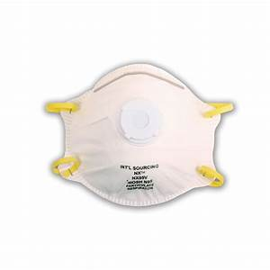
Masks

Slide 29
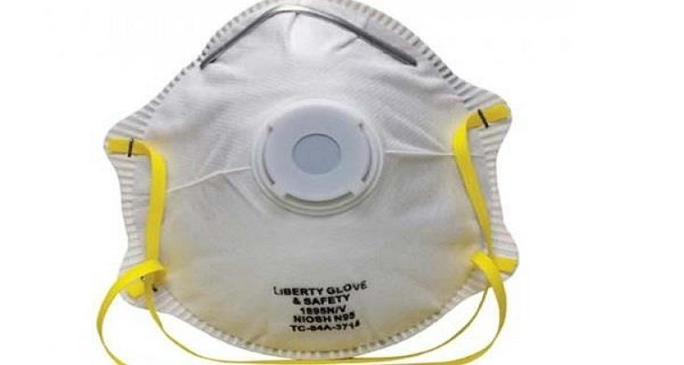
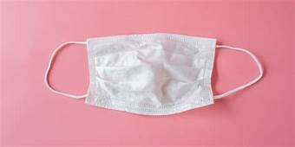
Masks

Slide 30
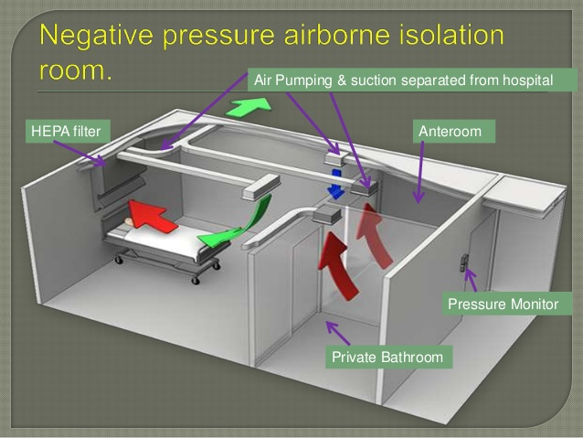

Slide 31
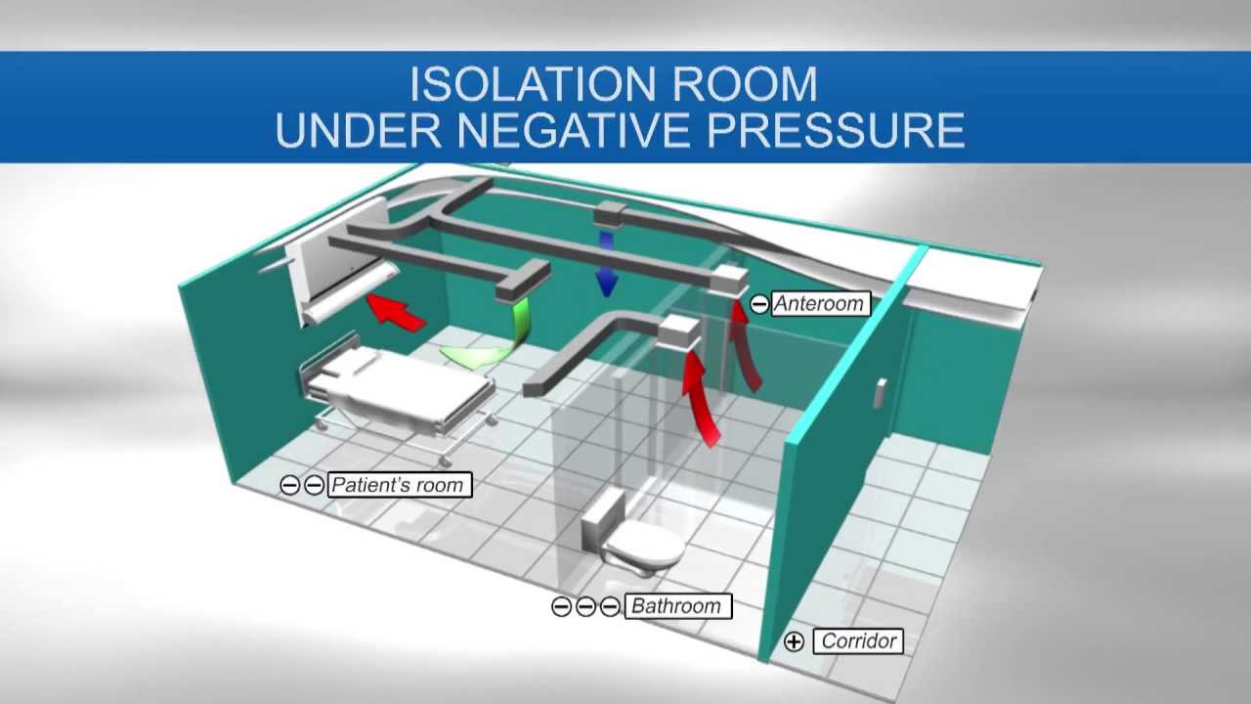

Slide 32
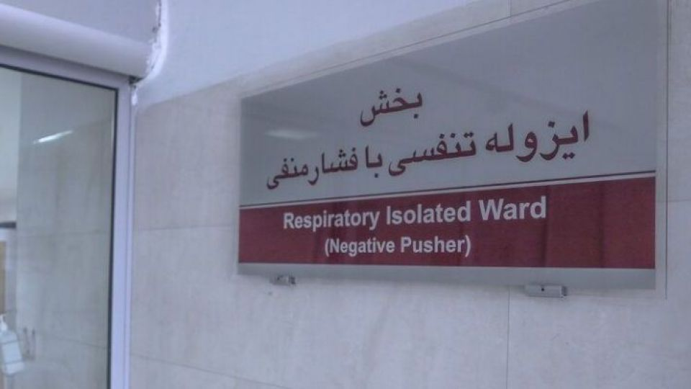

Slide 33



Slide 34



